Slide 1
Self- Attention
Positional Encoding
Appications

Slide 2
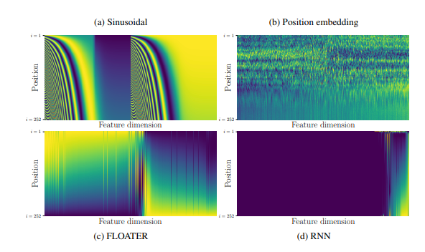

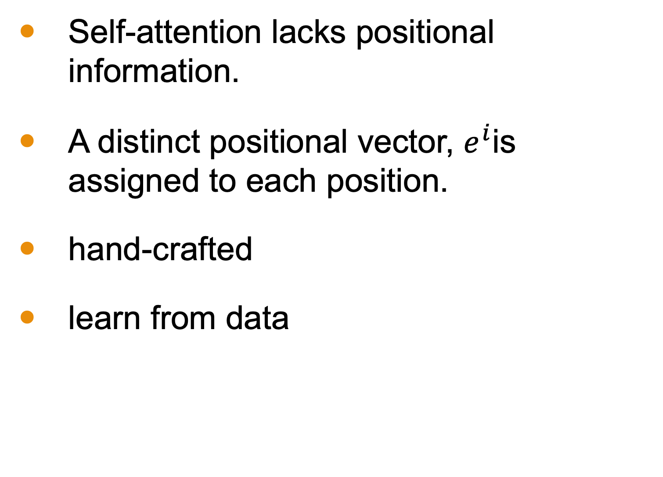




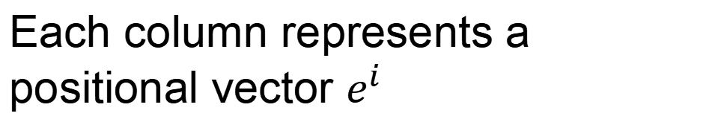
Positional Encoding
Each column represents a positional vector $e^{i}$
Self-attention lacks positional information.
A distinct positional vector, $e^{i}$is assigned to each position.
hand-crafted
learn from data
$$q^{i}$$
$$k^{i}$$
$$v^{i}$$
$$e^{i}$$
+
$$a^{i}$$
https://arxiv.org/abs/2003.09229

Slide 3
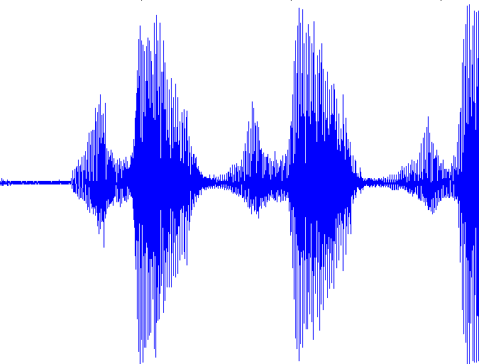




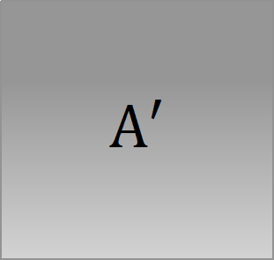






Self-attention for Speech
https://arxiv.org/abs/1910.12977
Attention in a range
Speech is a very long vector sequence.
$$b^{1}$$
$$b^{2}$$
$$b^{3}$$
$$b^{4}$$
10ms
If input sequence is length $L$
$$A′$$
$$L$$
$$a^{1}$$
$$a^{2}$$
$$a^{3}$$
$$a^{4}$$
Attention Matrix
$$L$$
Truncated Self-attention

Slide 4
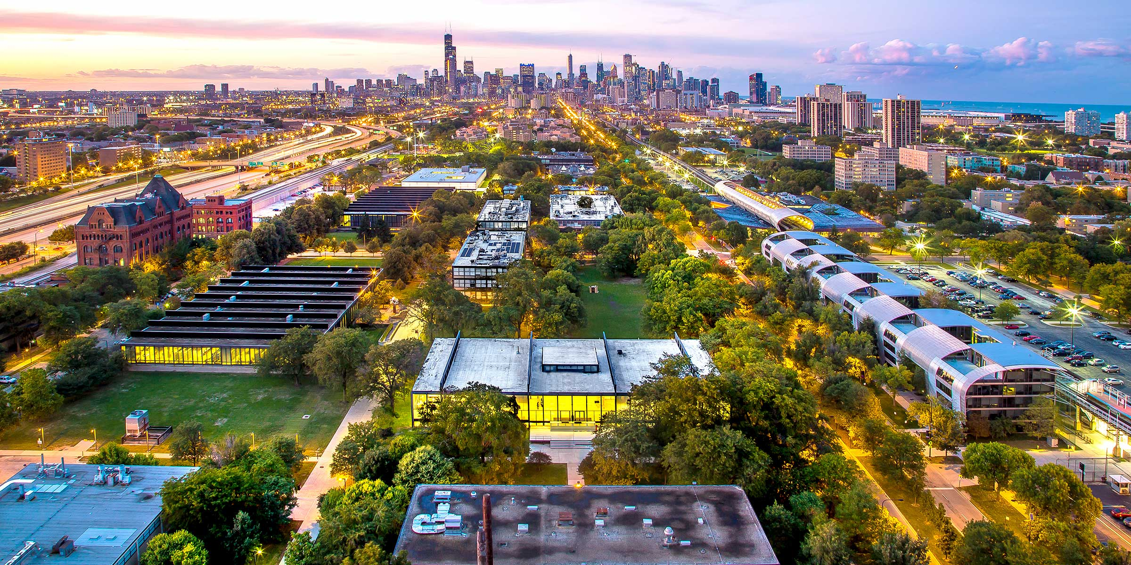
Self-attention for Image
A vector.
An image can also be viewed as a set of vectors.

Slide 5
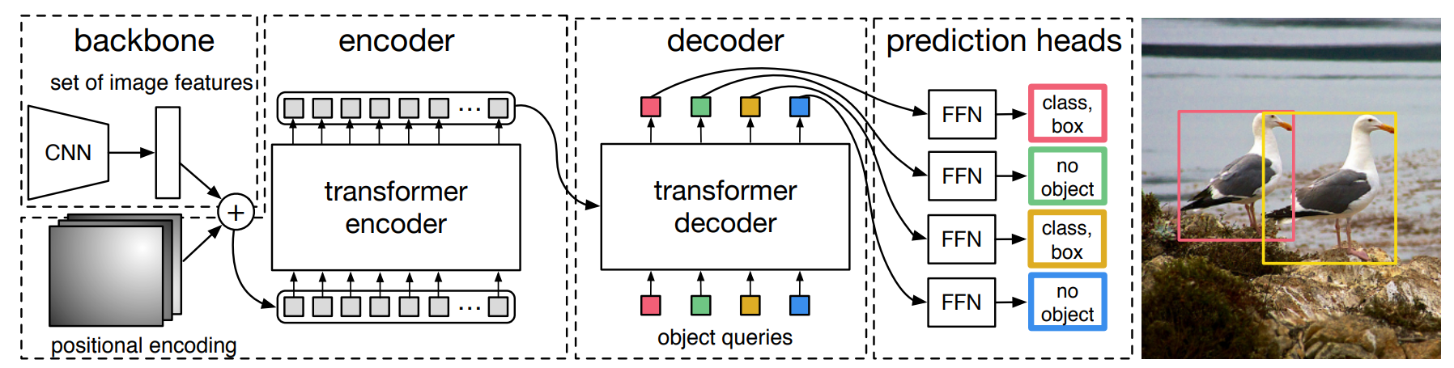
DEtection Transformer (DETR)
https://arxiv.org/abs/2005.12872
https://arxiv.org/abs/2005.12872

Slide 6
Self-attention v.s. CNN
Self-attention
CNN
1 | 0 | 0 | 0 | 0 | 1
0 | 1 | 0 | 0 | 1 | 0
0 | 0 | 1 | 1 | 0 | 0
1 | 0 | 0 | 0 | 1 | 0
0 | 1 | 0 | 0 | 1 | 0
0 | 0 | 1 | 0 | 1 | 0
CNN: self-attention that can only attends in a receptive field
CNN is simplified self-attention.
Self-attention: CNN with learnable receptive field
Self-attention is the complex version of CNN.
On the Relationship between Self-Attention and Convolutional Layers

Slide 7
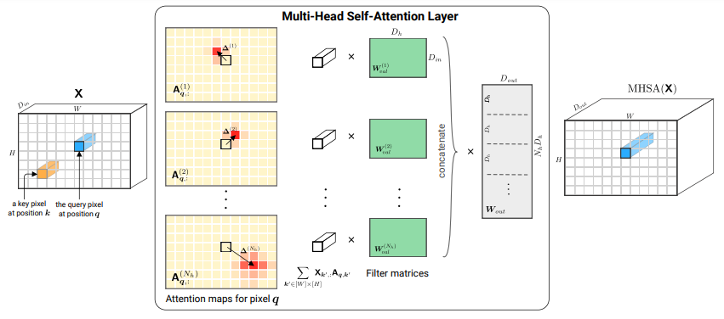
Self-attention v.s. CNN
On the Relationship between Self-Attention and Convolutional Layers
https://arxiv.org/abs/1911.03584

Slide 8

Self-attention v.s. RNN
FC
FC
FC
FC
memory
RNN
RNN
RNN
RNN
hard to consider
nonparallel
parallel
Self-attention
easy to consider
Transformers are RNNs: Fast Autoregressive Transformers with Linear Attention
https://arxiv.org/abs/2006.16236

